Slide 1


GonePhishin’ 🎣
Easy-Access Machine Learning for Phishing Detection
“ Tap Away Spam “
Notes:
Hello everyone, we are Sam and Parminder (MOJ), Zahra (DfT), Ameen and Lucy (MOD)
We are Gone Phishin’.
Easy-Access Machine Learning for Phishing Detection.
Our project takes aim at phishing, by proving an easy, 3-tap way to vet an SMS link using a sophisticated ML model and ‘Tap away spam’.

Slide 2



Fraud: the multi-billion-pound/year problem
*CyberEdge’s 2021 Cyberthreat Défense Report (CDR)
**The Latest Phishing Statistics
In the UK, fraud costs £27 billion annually*, with phishing accounting for a large portion of this.
Of UK businesses that suffered a cyber attack in 2022, 83% say the attack was phishing**.
Problem: anti-phishing services are hard to access, or closed to a particular app/software.
“ Tap Away Spam “
Notes:
So what is phishing? It’s a form of social engineering, where attackers deceive people into revealing sensitive information which can lead to identity theft, financial loss, and compromised personal information.
Phishing comes under a broad definition of ‘fraud’ which, according to some estimates, is a £27bn/year problem. And of businesses that have suffered a cyber attack, 83% say that it was some sort of phishing attack.
The problem .. while there are anti-phishing ML models often times it’s integrated into some closed service like Gmail. Ours is completely open and funded by government. It means that the second you get a dodgy message, you’re only ever a few taps away from our reliable model to give you some confidence.

Slide 3
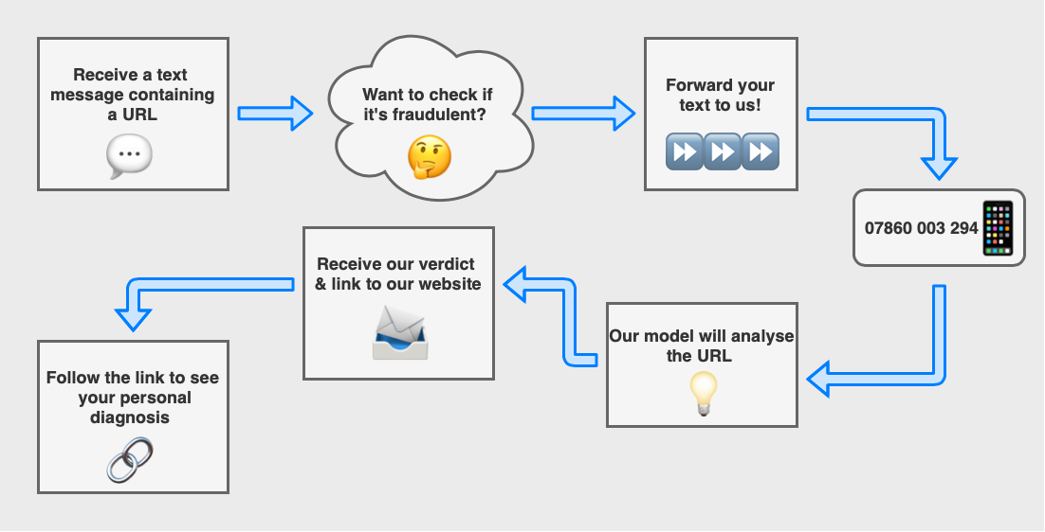
Our Strategy
“ Tap Away Spam “
Notes:
Here’s how it works - it’s super simple:
Receive a dodgy text containing a url. These can often be disguised as something like a tracking code
Don’t click the link, simply forward it to our Gone Phishin’ service
The script will extract your URL, the ML model will analyse the URL and you will receive a text back with a decision, and a link to our website for further details
If you have the GonePhishin’ number saved, this entire process can be done in 3, simple taps.
It does not involve consulting a separate service or copying and pasting from one place to another
It’s a near-instant data-driven prediction.

Slide 4

GET INVOLVED!
Forward/Send any message to 07860 003 294 It could be a spam message, or just a website you know and trust
“ Tap Away Spam “
Notes:
We thought that the best way to explain our project is to get involved, and see for yourself how it works.
Here’s our number on screen.
Feel free to write a text to this number with a link of your choice (you can also add text to the SMS or forward an actual suspicious SMS instead of just a link.)
Don't worry too much about writing this number down - as the number will be available on the rest of our slides,
In the meantime, we will show you a quick demo of what this service is supposed to look like.

Slide 5

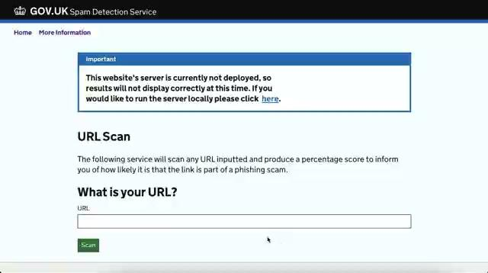
Demo
07860 003 294
“ Tap Away Spam “
Notes:
In case you don’t get a chance to text our service, we have prepared two demos - on the left, our SMS service, and on the right our web-based service.
The SMS service is built using GOV.UK Notify API.
What’s nice about our service, is that it automatically scans forwarded texts, then extracts the URL, and runs it through our machine learning model to check for spam."
If you have the number saved, this entire process can be done in 3, simple taps.
On the web-based service, which was built using react and the government css-framework, you’re able to input your URL which will generate the percentage score using the API and also tell you in more detail how likely it is that the URL is a scam. At the end of the video there you can also see the second page of the website which contains more information about phishing in general so people who visit the website can educate themselves a bit more on the topic and hopefully learn how to spot when they’ve been sent a spam link.

Slide 6




How we did it
* Github: GregaVrbancic/Phishing-Dataset
** we define model ‘accuracy’ as the F1-score (a more robust metric)
07860 003 294
Open-source phishing
dataset with 60k
data points*
ML Tests NB: 56% SVC: 70% RF: 78% XGBoost: 92%**
Integrated the ML model into gov.uk ‘Notify’ service to reply to text messages
Built a React website that messages a Flask API to provide more information
“ Tap Away Spam “
Notes:
Just briefly touching on how we built the service - starting with the data. We used an open-source phishing dataset with ~60,000 datapoints - half known phishing, half known legit websites.
The dataset features contained things like the url length, the number of special characters in the URL, if the link has a valid SSL certificate, etc.
We started with simple models like Naive Bayes and support vector classifiers, then tried out a random forest, before eventually ending up with trusty ol’ XGBoost, which gave us a 92% prediction accuracy on our testing dataset. Initially we didn’t actually trust this accuracy because it seemed so high - we were worried about it overfitting. But after performing cross-validation and testing on real-world examples outside of the dataset, we realised that those numbers were pretty accurate. So yet again, applying XGBoost has been the answer to all of our problem (no surprise there)
Once the model was built and performing suspiciously well, we started work on the backend. As you’ve seen we have two interfaces: the SMS system and the website if you’re on a browser.

Slide 7


Closing Notes
07860 003 294
Potential improvements
Continuous training
Expand to email and social media
Browser extension for greater accessibility
Impact assessment
Risk to UK economy
Saves heartache
Low cost to operate
“ Tap Away Spam “
Notes:
So that’s what we have built so far. We have plenty of ideas on how to improve our work. One of the difficulties of phishing scams is that they are constantly evolving, and bad actors, are always coming up with more sophisticated ways of fooling people.
Given more time and resource, we’d likely set up a continuous training system, which pulls in new data and re-trains the algorithm regularly. Also, on accessibility, expanding to e-mail, social media, and a browser extension.
This leads us to our impact assessment - why did we build this?
Well if you remember from our initial slides, phishing is an expensive problem, and has a sizeable impact on the UK economy.
Even if we prevent just 1% of phishing scams through our service, we could save tens or hundreds of millions of pounds, - and a lot of heartache.
We also believe this will be a pretty cheap service to run, relative to the potential savings.

Slide 8
GonePhishin’ 🎣
07860 003 294
“ Tap Away Spam ”
Notes:
Thanks for testing our service.
We’ll now welcome any questions from the audience.
Together - Let’s Tap Away Spam!
Rap if there’s time? :P

